Slide 1
The SUNY – wide CIDR project.
Where are we?
Werner Ceusters, MD
Prof., Department of Biomedical Informatics
Dir. of Research, UB Institute for Healthcare Informatics
Dir., National Center for Ontological Research

Slide 2
Long-Term Goals
Develop and Maintain a centralized clinical integrated data repository (CIDR) of SUNY EHR Data
Use this CIDR as a research asset for SUNY investigators
Notes:
Pulled from Objective section of RFP

Slide 3
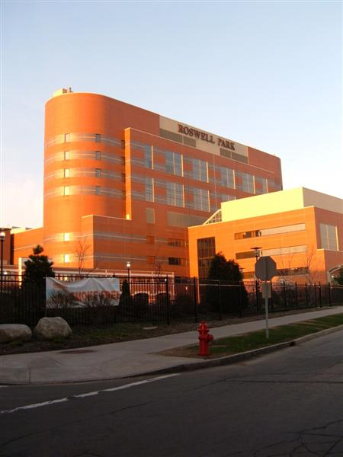
Semantic Interoperability: the goal
Everything collected wherever, whenever and about whomever which is relevant to a medical problem in whomever, whenever and wherever, should be accessible without loss of relevant detail.

Slide 4
Initial EHR Database Assessment
Representing and Failing to Represent in EHR Data (Bona, Ceusters)
Based on ontological realism and referent tracking
Goal: Understand questions easily answered by EHR interface but difficult to answer with database

Slide 5
Initial EHR Database Assessment (con’t)
Issues
Multiple entries stand for same entity
Single entry that stands for more tan one entity
Entries unclear about temporal distinctions
Entries incorrectly marked as Entered in error or Resolved
Entries that are wrong or outdated but still marked as Active

Slide 6
Ontology based data warehousing

Slide 7
Five Core Report Goals
Catalog EHR assets across all SUNY entities that provide clinical care
Review the regulatory environment for clinical data research
Organize stakeholder meetings
Review collected information to create a roadmap for CIDR creation
Host a CIDR summit to review and discuss the findings
Notes:
Derived from five core activities

Slide 8
Questionnaire
79 questions
Distributed to SUNY and SUNY-related clinical organizations
Components:
Demographic data
Organizational environment
EHR system characteristics

Slide 9
Groups contacted
SUNY Buffalo |  | SUNY Upstate
ECMC | UB Orthopedics | Crouse Hospital | Privacy Office
UB Anesthesiology | UB Otolaryngology | Epic Systems | St. Joseph’s hospital
UB Emergency Medicine | UB Pathology | IMT Administration | UHS Binghamton
University Radiology | UB Vascular Surgery Lab | Lourdes Hospital | UHS Wilson Medical
UB Neurosurgery | Healthcare Informatics | Pediatrics
UB Nuclear Medicine | UBMD
UB Ophthalmology | Kaleida Health
SUNY Downstate | SUNY Albany
SUNY Downstate Medical Center | Information Studies
Medical Compliance Office | SUNY Albany School of Public health
Notes:
Table 1. This is what we started out with, although the list was eventually pared down.

Slide 10
Questionnaire Completion Rate
Institutions which responded
UB Associates
UB Emergency Medicine
UB Ophthalmology
UB Radiology
Kaleida Health
SUNY Downstate
Crouse Hospital
UB Orthopedics
UB Otolaryngology
ECMC
Institutions which did not
UB Anesthesiology
UB Neurosurgery
UB Nuclear Medicine
UB Pathology
UB Vascular Surgery Lab
St. Joseph’s Hospital
Binghamton General Hospital
UHS Wilson
Notes:
What do you mean with data sets? EHR data?

Slide 11
Core Task One – Catalog SUNY EHR Assets
Reported Electronic Health Records in use
Allscripts Touchworks Allscripts Sunrise Clinical Manager Epic Medflow Cerner Siemens Invision Medent CPRS Meditech Vista
Notes:
Distinct EHR names in Table 3. Is Medent different from Medent EHR? Is it Siemens instead of Seimens?

Slide 12
EHR Statistics on submitted reports
Clinical Group | Providers | Inpatient | Outpatient | Total
UBMD | 475 | - | 90,000 | 90,000
Upstate Medical University | 1100 | 30,000 discharges / year | 500,000 visits/ year | 1,509,247
UB Ophthalmology | 21 | - | 60,000 | 60,000
UB Orthopedics | 99 | - | 272,673 | 272,673
UB Otolaryngology | 4 | - | 19,800 | 19,800
Kaleida Health | 2,400 | 1,500,000 | - | 1,500,000
Downstate Medical Center | 300 | - | 640,000 | 640,000
ECMC | 940 | 843,123 | 53,928 | 897,051
Notes:
Information from table 3. Not all EHRs are represented here because some practices didn’t provide any of this information.

Slide 13
Reported RHIO Connections
Clinical Group | RHIO Connection
UBMD | HEALTHeLINK
Upstate Medical Center | HealtheConnections
UB Emergency Medicine | HEALTHeLINK
UB Orthopedics | HEALTHeLINK, Greater Rochester RHIO, HealtheConnections, HIXNY
UB Otolaryngology | HEALTHeLINK
Kaleida Health | HEALTHeLINK
Notes:
Table 4

Slide 14
Special Population Identification
Special Population | Identification Rate
Children | 73%
Elderly | 64%
Impoverished | 18%
Underrepresented Minorities | 45%
African-Americans | 73%
Hispanics | 73%
Native Americans | 73%
Pacific Islanders | 55%
Childhood Illness Survivor | 36%
Notes:
Slide 10. ‘Identification Rate’ column is respondents that said “yes” in questionnaire. No answer, unknown, or negative confirmation are all not counted in this number.

Slide 15
Data Extraction for Research
Several analytic databases currently in use among SUNY clinical groups
Data taken and separate from production databases
Production → Analytic ‘translation’ issues
Information in different fields
Missing data
Fields merged
Notes:
From section 5.1.5

Slide 16
Core Task Two – Regulatory Environment
No reported contractual data sharing agreements that would provide restrictions other than legal
Many ‘unknown’ answers
Interpretation of
HIPAA Compliance
IRB Compliance
Patient Consent
Notes:
HIPAA, IRB, and consent forms are all larger issues. The contractual bit is just about whether anyone said “we can’t share our medical data because we have an agreement with X that prevents it.” Nobody did say that, so theoretically, everyone is legally allowed to share their data.

Slide 17
Core Task Three – Stakeholder Meetings
Bi-Weekly Status Meetings
Quarter one meeting held in Albany (SUNY Albany)
RHIO connectivity, SUNY Buffalo EHR activity, conversion and interoperability of EHR data
Quarter two meeting held in Syracuse (SUNY Upstate)
Regulatory roadblocks, coordinating different data sources
Quarter three meeting held in New York City (SUNY Downstate)
Compliance concerns, possible technical architecture

Slide 18
Core Task Four – CIDR Roadmap
Goals outlined for task four have proven extremely challenging to complete
Needs:
More technical details (data dictionaries)
More clarity about legal and regulatory concerns
Institutional commitment

Slide 19
Core Task Five – CIDR Stakeholder Summit
This meeting
Goals:
Review results of collection efforts
Come to a consensus on conclusions drawn
Make recommendations on how best to proceed

Slide 20
Barriers and Obstacles
Interfaces between EHRS
Concerns that EHRs are not interoperable
Data dictionaries
Only one currently available
Institutional resistance
Fears over HIPAA and IRB compliance
Legal concerns regarding sharing, possession, and security of data
Notes:
Interfaces between EHRs is fairly solvable. Interfaces between all EHRs is theoretically possible. Problem is that in business environment, often not worth the time/money/effort necessary to implement. This project would be mapping all EHR databases to ontology. Time-intensive, but possible.

Slide 21
Barriers and Obstacles (con’t)
Institutional resistance
Participation in RHIOs and SHIN-NY reduces perceived importance of CIDR
Some consider CIDR not worth time/effort/money
Lack of technical data
Questionnaires answered by directors, not individuals with intimate technical knowledge
Notes:
The “lack of technical data” one can be solved by talking to people lower in the management chain that actually use the EHR on a daily basis and understand it better than directors/C-suite does

Slide 22
Conclusions

